Slide 1
North Tennessee Watershed Analysis
David Jean and Jon Allen

Slide 2
About the Sites
01
Passenger Creek
02
Shadybrook Bridge
03
Brown’s Confluence
04
River Road
Grant’s Chapel Road - 36º31’53” N 87º10’35”W
Shadybrook Lane at Bridge, Tributary to Brown’s Branch - 36º38’17” N 87º12’08”W
Confluence with Brown's Branch - 36º38’18” N 87º12’10”W
River Road - Tributary to Red River - 36º38’01” N 86º48’22”W

Slide 3
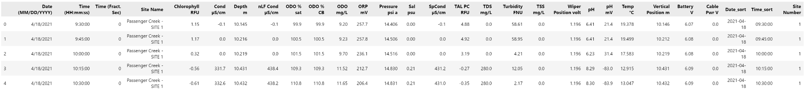
Our Data
Dissolved Oxygen
pH
Temperature

Slide 4
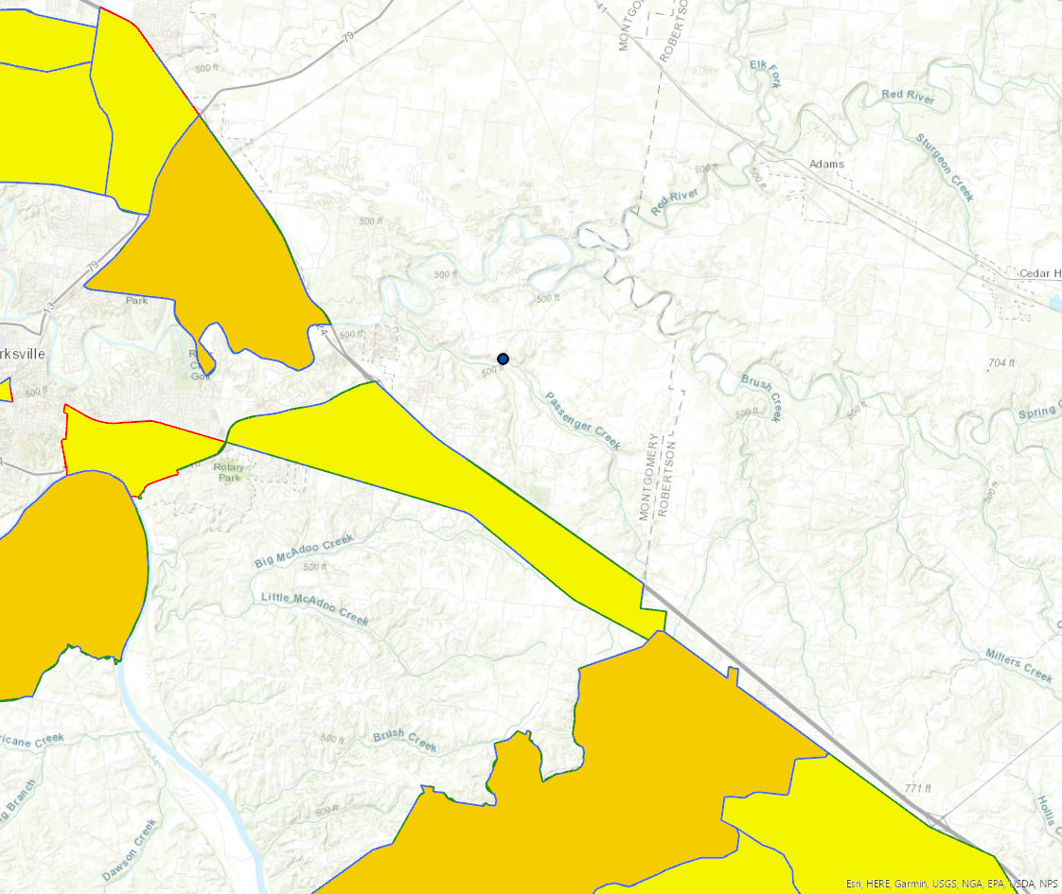
01
Passenger Creek
Grant’s Chapel Road - 36º31’53” N 87º10’35”W

Slide 5
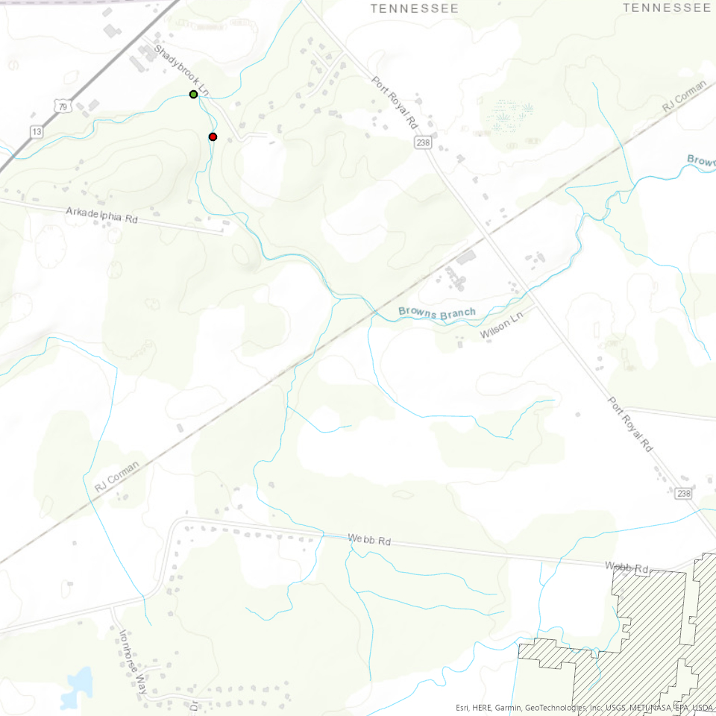
02
Shadybrook Bridge
Shadybrook Lane at Bridge, Tributary to Brown’s Branch - 36º38’17” N 87º12’08”W

Slide 6
03
Brown’s Confluence
Confluence with Brown's Branch - 36º38’18” N 87º12’10”W

Slide 7
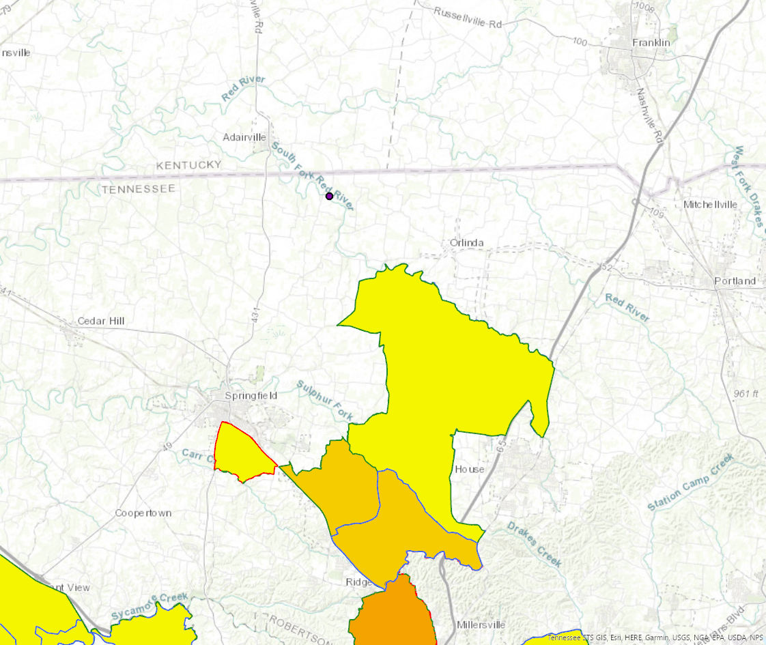
04
River Road
Tributary to Red River - 36º38’01” N 86º48’22”W

Slide 8
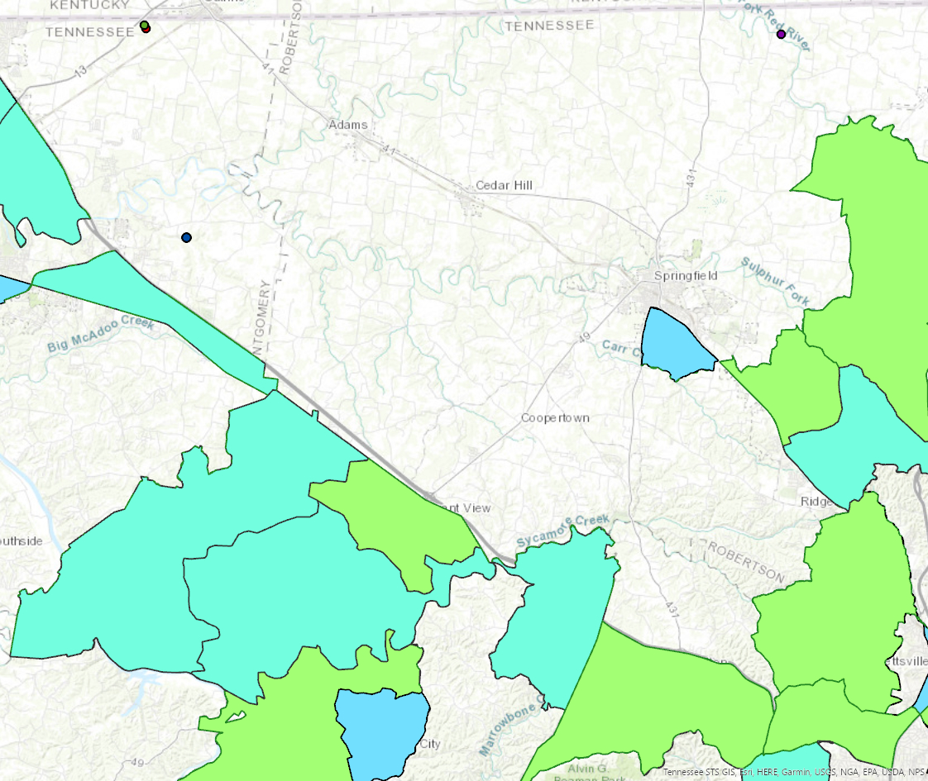
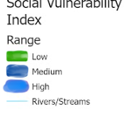
Social Vulnerability
High Impact Areas

Slide 9
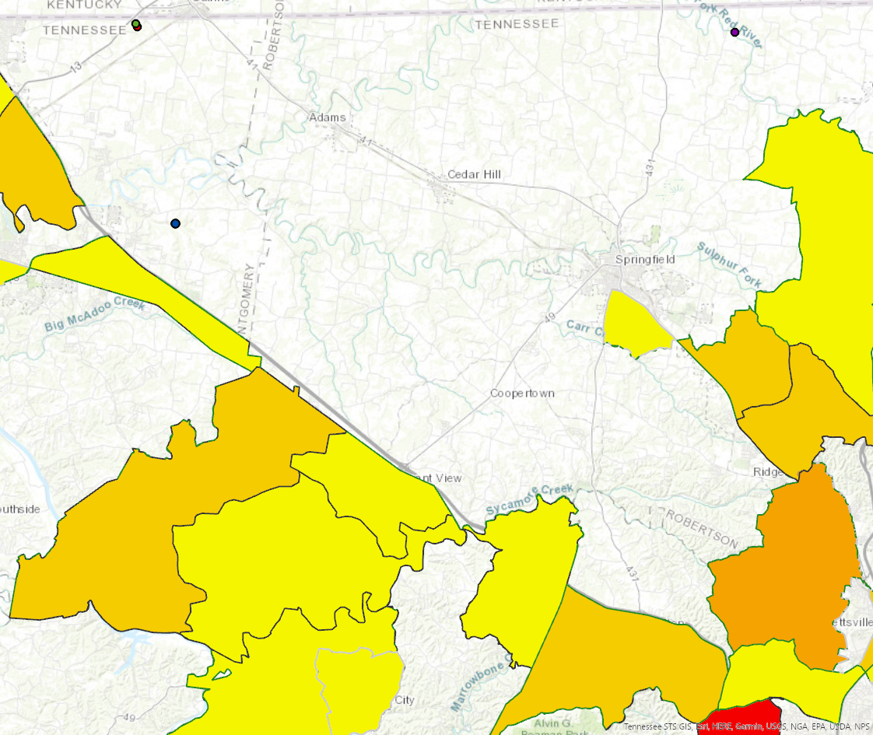
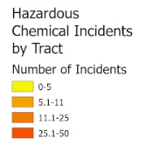
Hazardous Incidents
High Impact Areas

Slide 10
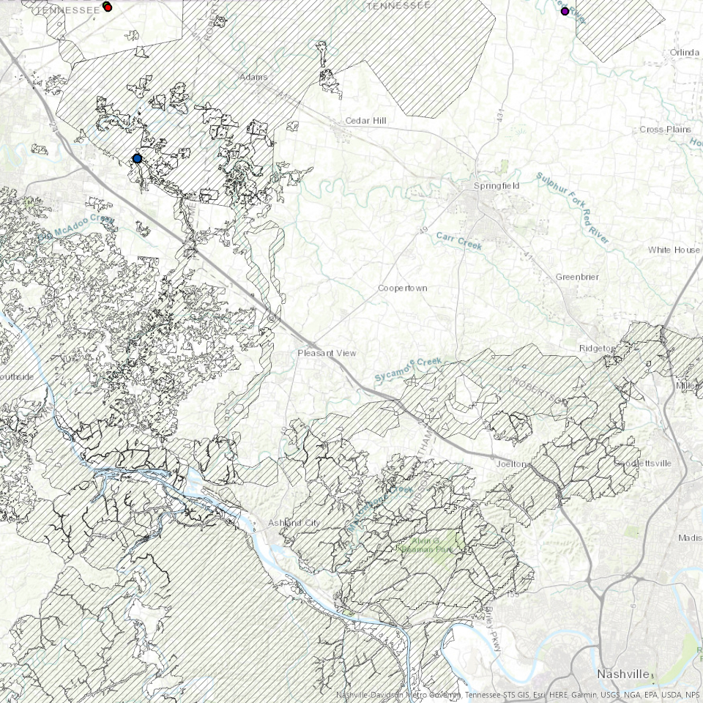
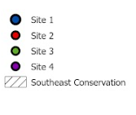
Conservation
Areas
High Impact Areas

Slide 11
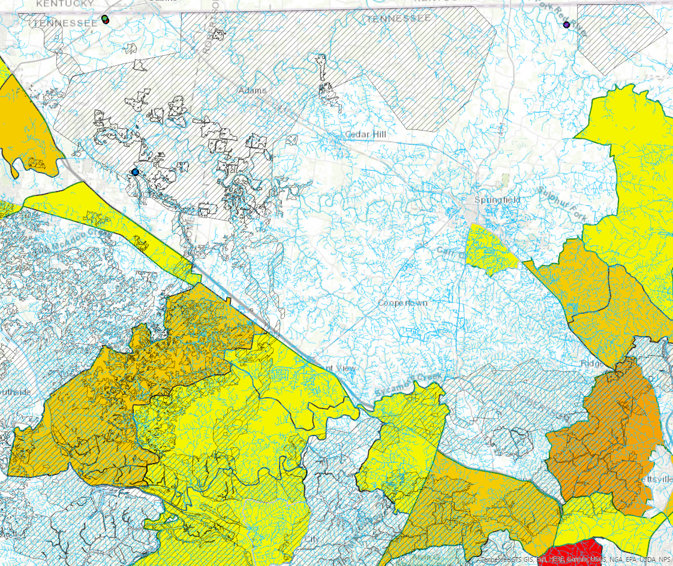
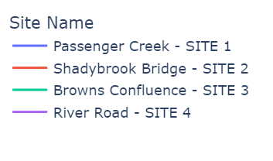
All Layers
Conserved Areas, Number of Hazardous Incidents

Slide 12
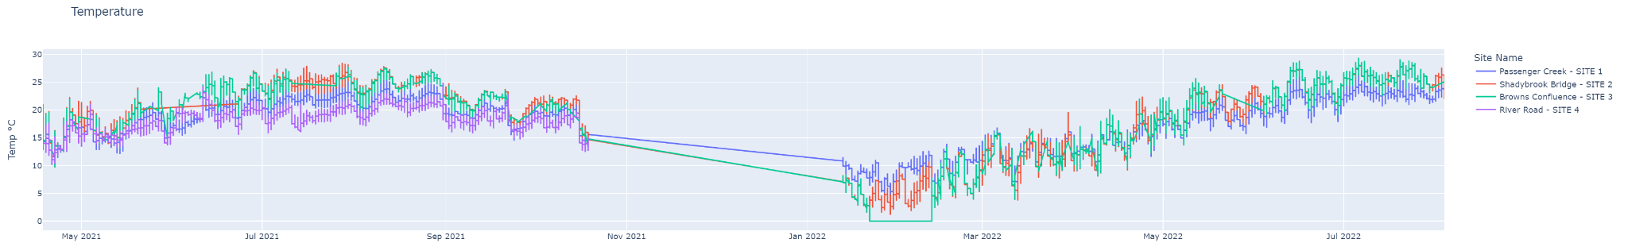
As time moves on….
May 2021
Nov 2021
Aug 2022
Sensors Deployed
Sensors down for maintenance
Data Extracted

Slide 13
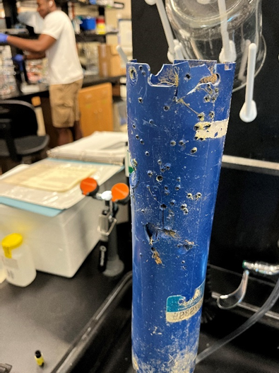
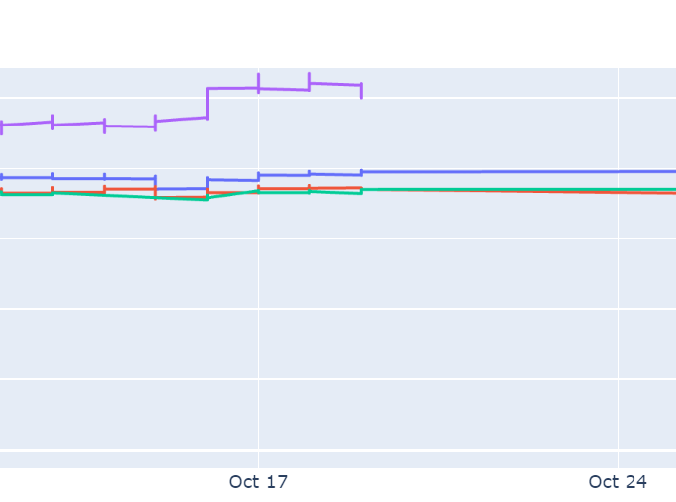
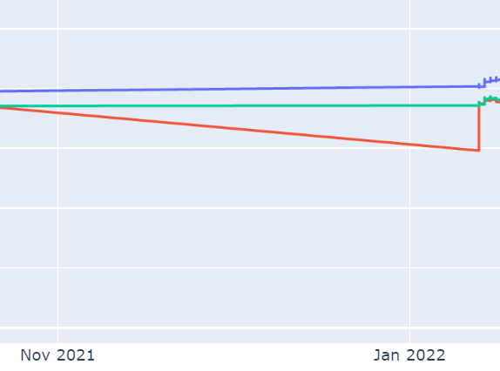
Critical moments during the study
RIP Site 4.
Gone but not forgotten
October 19th
Nov-Jan
Site 4 is permanently damaged from a shotgun blast
All Sites down for cleaning and maintenance

Slide 14
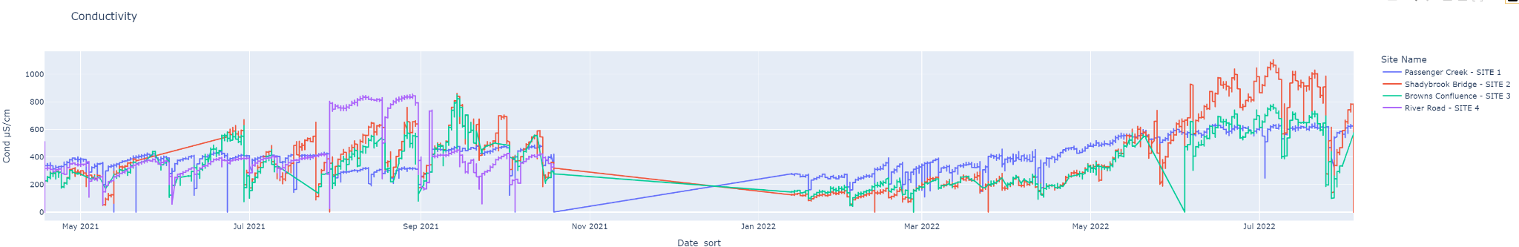
Conductivity
Measures electrical conductivity. Typical range is between 0 and 1500 for freshwater.

Slide 15
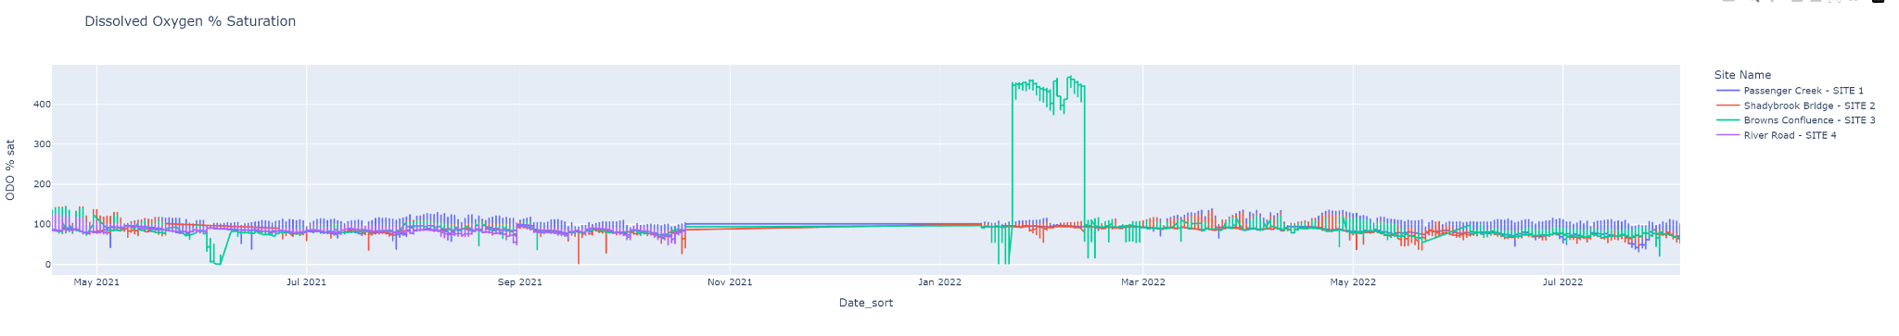
Dissolved Oxygen
Typical range is between 80 and 120%

Slide 16
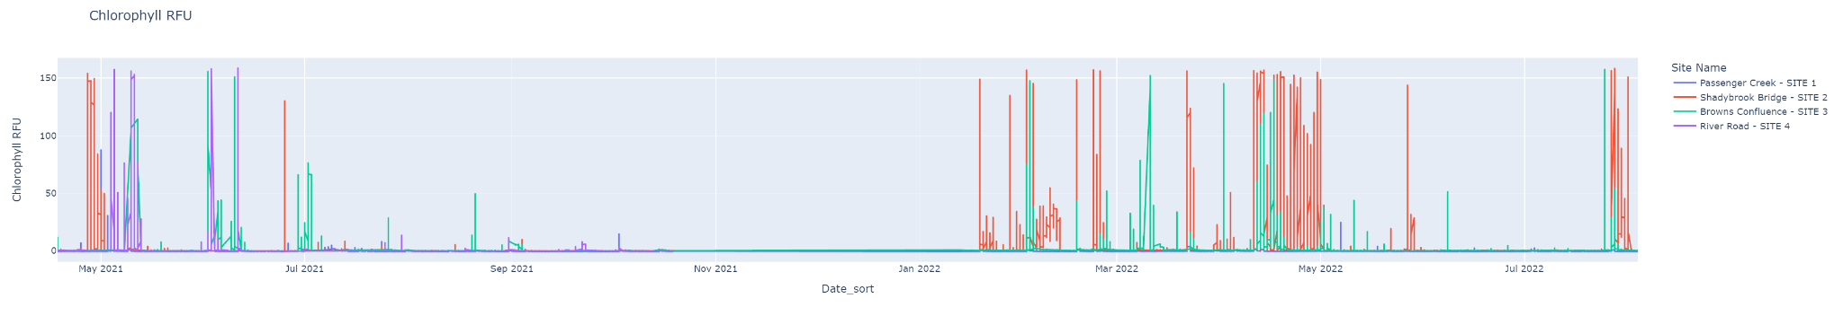
Chlorophyll Relative Fluorescence unit
High levels over time can indicate poor water quality. Site 2 Appears to be of concern.

Slide 17
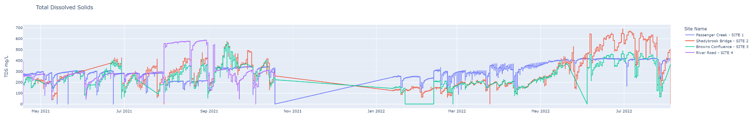
Total Dissolved Solids
Between 50-150 is considered suitable. We can see that site 3 spikes at close to 700.

Slide 18
Contributing Factors
Alternative food source
Alternative fuel source
Increases jobs in the market
Reduce seafood trade deficit
Reduces fishing pressure on wild stock
Low environmental impact
Water usage
Farming

Slide 19
Sources
Our sources range from locally harvested data to data from tn.gov
Advanced In-Stream Water Quality Monitoring of the Red River Watershed, Bailey, Otter.
Tennessee National Toxic Substance Incidents Program; Social Vulnerability Index. CDV/ATSDR/Division of Health Studies/Geospatial Research, Analysis & Services Program. Retrieved April 30, 2010 from ftp.cdc.gov/pub/ATSDR/census-svi/SVI_Database
The Southeast Conservation Blueprint with TN Cumberland River Basin. Retrieved from secassoutheast.org
Tennessee Hydro Lines and Waterbodies. Nov 26, 2018. Retrieved from tn-tnmap.opendata.arcgis.com/search?tags=environmental

